Slide 1


V-Guard Sentinel
The inverter already knows when the power goes. Sentinel teaches it what to keep on — and when its battery will quit.
Track 4 · From Smart Products to Intelligent Products
Team Codey Tingle (TI3271) · Ayush Manoj Garg · Eshan Shukla · Tanay Chaplot
Finale · Kochi · 24 September 2026
Notes:
[0:00–0:20] Good morning. We're Team Codey Tingle. In the next ten minutes we'll show you Sentinel — first the idea, then the working prototype live, then what's proven and what isn't. Behind us is our simulated village; you'll see it in action in a few minutes.

Slide 2

10:03 pm. The battery dies — with no warning.
Three hours into a power cut, Home 6 in our village goes dark. Home 1 has the same battery and appliances — and stays lit.
85 %
of Indian households face a power cut every day (LocalCircles, 2023)
×2 wear
every +10 °C: lead-acid life halves with heat — the Indian summer is the battery's enemy
≈ 1.5 %
of V-Guard revenue goes to warranty (≈ ₹69 cr, FY24)
V-Guard Sentinel · Big Idea Tech 2026, Track 4 · Team Codey Tingle (TI3271)
2
Notes:
[0:20–0:50] Picture a family in Kochi. The evening power cut starts at seven. The inverter switches over in under ten milliseconds — it's fast. But nobody knows how much the battery has left, or how healthy it is. At three minutes past ten it simply dies: fridge, Wi-Fi, lights, all gone. Eighty-five percent of Indian homes face cuts daily. Heat halves lead-acid life every ten degrees. And for V-Guard, those surprise failures land in the warranty bill — about one and a half percent of revenue. The inverter is fast. The battery is blind. That's the gap.

Slide 3
Sentinel turns a smart inverter into an intelligent one.
Smart products take commands. Intelligent products predict, decide and act — without the cloud.
CONNECTED
app on / off
SMART
schedules · alerts · usage
INTELLIGENT
predicts failure · learns the home
acts on its own — offline
← Sentinel
1
Embedded a daughter-board inside new V-Guard inverters
2
Retrofit a 30-minute electrician fit on the installed base
3
Offline-first every core function works with zero internet
V-Guard Sentinel · Big Idea Tech 2026, Track 4 · Team Codey Tingle (TI3271)
3
Notes:
[0:50–1:10] Our idea in one sentence: Sentinel turns V-Guard's smart inverter into an intelligent one. Today's products take commands. Sentinel predicts when the battery will fail, decides which loads to keep alive, and acts on its own — even with no internet, which in India is a feature, not a compromise. It ships two ways: built into new inverters, or retrofitted by an electrician in half an hour.

Slide 4
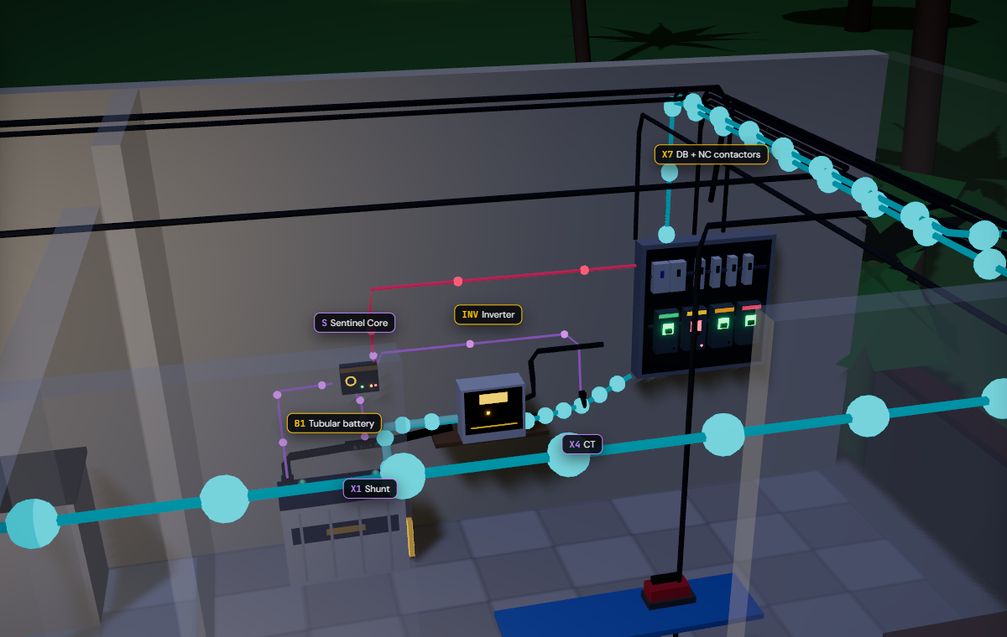
One small box reads the battery and switches the loads.
Nothing on the battery or the inverter is modified on the retrofit — only the negative cable passes through a shunt.
1
Shunt in the battery − lead
battery current → INA228
2
NTC on the battery post
temperature: the #1 ageing driver
3
CT + voltage tap on AC-OUT
real & reactive power → ATM90E32AS
4
4 NC contactors in the DB
coil off = load ON, always
5
ESP32-S3 Sentinel Core
90 × 70 × 35 mm, powered by the battery
V-Guard Sentinel · Big Idea Tech 2026, Track 4 · Team Codey Tingle (TI3271)
4
Notes:
[1:10–1:35] Physically, Sentinel is a box the size of a deck of cards beside the inverter. This is the 'power corner' of Home 1 in our simulation. Five touch points: a shunt in the battery's negative cable for current, a temperature probe on the battery post, a current transformer on the inverter output, four fail-safe contactors in the distribution board — and the ESP32 core itself. Gold dots are mains power, cyan is battery power, violet is Sentinel sensing.

Slide 5
Four jobs, one board — all on the ESP32, no cloud needed.
1
2
3
4
Battery health
Habit autopilot
Energy coach + grid shield
Signed health log
Predicts a replacement window — 'replace in 6–14 weeks'
Keeps the fridge, lights and router alive during a cut
Names the big appliances; logs every sag and swell
Tamper-proof record — warranty decided by evidence
Same core, same sensors, different models → the platform extends to pumps, stabilisers and water heaters.
V-Guard Sentinel · Big Idea Tech 2026, Track 4 · Team Codey Tingle (TI3271)
5
Notes:
[1:35–1:50] Four jobs, one board. One: battery health — a warning window, not a guess. Two: the autopilot that keeps essentials alive. Three: the energy coach and grid shield — which appliances use what, and what the grid did to your home. Four: a signed health log, so warranty is decided by evidence, not argument. Let me take them one at a time, quickly.

Slide 6
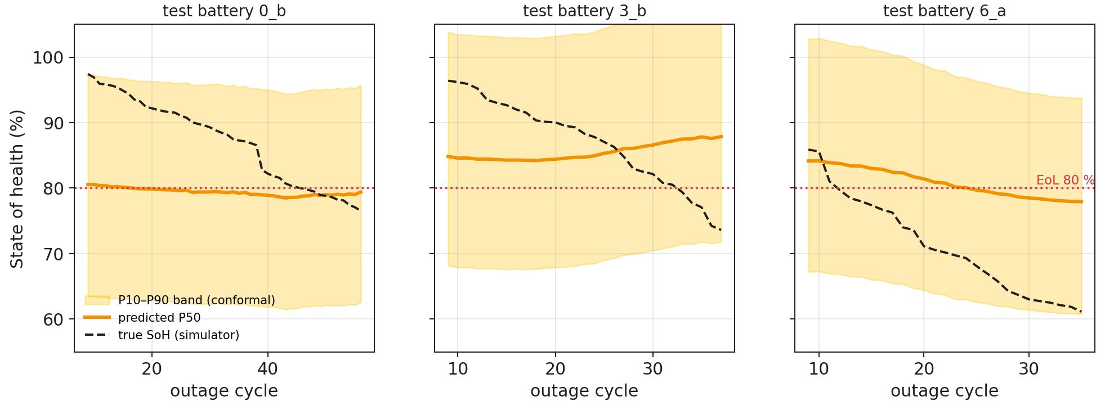
It gives a window, not a date: "replace in 6–14 weeks".
Physics first, learning second — every step runs on the ESP32.
1 Hz sensing
I · V · T
Kalman filter
SoC · R_int
14 + 6 features
per outage cycle
int8 CNN × 3
28 k params · 16 KB
Grade
window, never a date
8.2 pt
SoH error on 3 never-seen test batteries (synthetic data — honest, not flattering)
+0.01 pt
accuracy lost going float → int8 — it fits on the chip for free
Band is calibrated but wide today; the Kochi aging campaign narrows it.
V-Guard Sentinel · Big Idea Tech 2026, Track 4 · Team Codey Tingle (TI3271)
6
Notes:
[1:50–2:25] How does a small microcontroller predict battery life? Physics first. A Kalman filter turns current, voltage and temperature into charge and internal resistance. Each outage becomes 20 features the lead-acid literature says drive wear — resistance growth, heat stress, depth of discharge. A tiny int8 network — 28 thousand parameters, 16 KB of RAM — outputs a band, and we show a window: replace in 6 to 14 weeks, plan for 6. Honest numbers: on three batteries the model has never seen, the error is 8.2 points — on synthetic data. The band is calibrated but wide; real tubular aging data from the Kochi lab is what narrows it. And quantising to int8 cost us one hundredth of a point.

Slide 7
Same outage, same battery: only Home 1 keeps its fridge on.
Battery charge through the 7–11 pm cut, straight from our simulation engine; thresholds from design doc 05.
57 min
Home 6 sat in the dark until mains returned at 11 pm
8:24 pm · fans & TV deferred
(T2 at 55 %)
0 min
Home 1's fridge, router and hall light were never off
10:37 pm · heavy sockets shed
(T3 at 40 %)
Coil off = load on.
NC contactors, a hardware supervisory timer and a medical jumper: any crash or reset brings every load back.
10:03 pm · Home 6 cut-off:
fridge, router, lights OFF
V-Guard Sentinel · Big Idea Tech 2026, Track 4 · Team Codey Tingle (TI3271)
7
Notes:
[2:25–3:00] This is the heart of it, and it isn't a drawing — it's the output of our simulation engine. Home 1 and Home 6 have the identical 150 Ah battery and identical appliances. Only Home 1 has Sentinel. At 8:24 pm Home 1 drops to 55 percent and defers the fans and TV; its curve flattens. Home 6 keeps burning everything, and at 10:03 pm hits the cut-off — fridge, router, lights, all off for 57 minutes. Home 1 sheds the heavy sockets at 40 percent and keeps its essentials on till mains returns. The rule is a readable ladder — 55 and 40 percent with hysteresis — not a black box. And every contactor is normally-closed: if Sentinel crashes, every load comes back on.

Slide 8
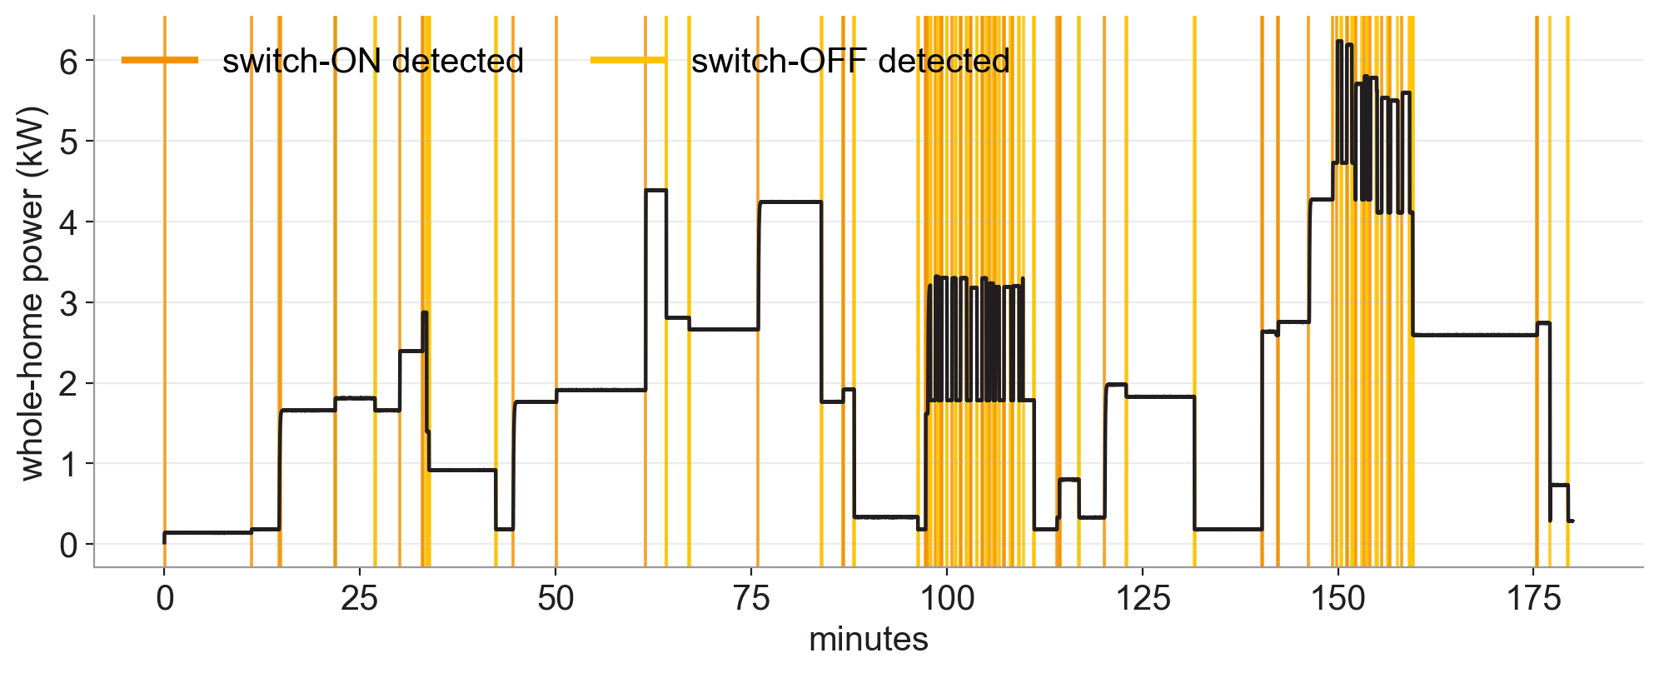
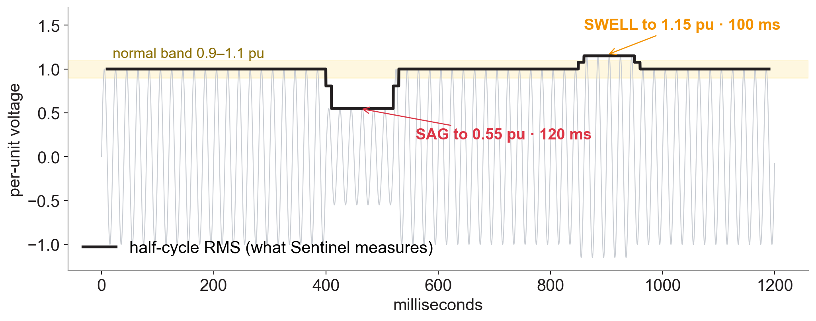
One sensor saves energy and catches a misbehaving grid.
Both run on the metering front-end (ATM90E32AS) and the isolated voltage tap (AMC1311) — outputs of the team's own detector code.
Energy Coach 123 switch-ON/OFF events found in 3 h of whole-home power; each becomes a 13-number signature. Fridge F1 0.97, iron 1.00.
Grid Shield a 120 ms sag to 0.55 pu measured as 0.54; a 100 ms swell to 1.15 pu as 1.16. 13 / 13 dips caught. Logged, dated, signed.
V-Guard Sentinel · Big Idea Tech 2026, Track 4 · Team Codey Tingle (TI3271)
8
Notes:
[3:00–3:25] Engine three. We added a real metering chip on the inverter output — the kind inside a smart meter. On the left, three hours of a home's power: every orange line is an appliance switching on, gold is off — 123 events, each turned into a signature so the app can ask 'what just turned on?'. On the right, the grid shield: the chip computes RMS every half cycle, catches a 120-millisecond sag and a swell, and writes them into the signed log — evidence for the owner when a fluctuation damages an appliance. We're honest about scope: big appliances, not two identical fans.

Slide 9
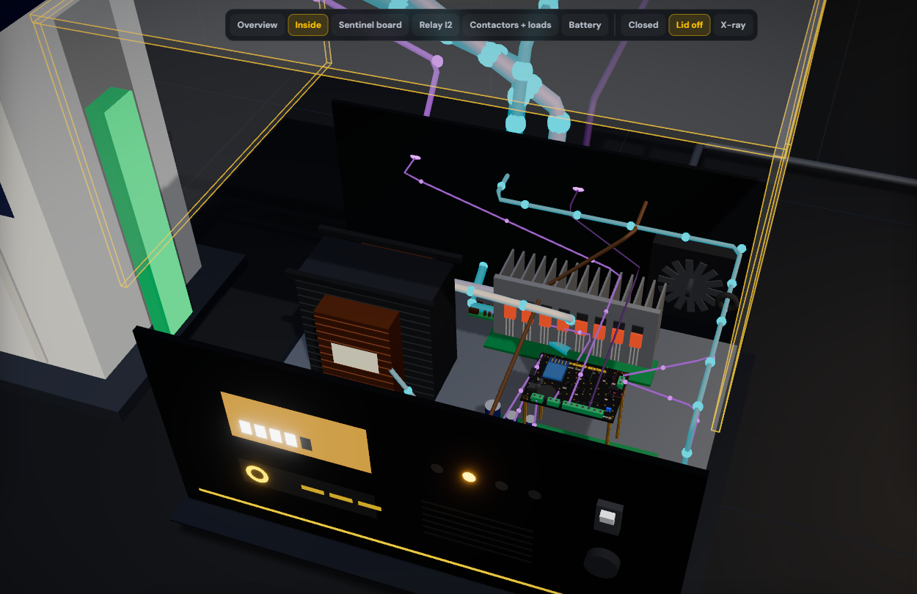
Inside the inverter, Sentinel taps what's already there.
Our 3D proof of concept of the Embedded SKU: lid off, every part clickable, live power flow.
1
Inverter's own shunt (I8)
→ INA228 · battery current
2
Mode / mains line
→ PC817 opto · outage vote s2
3
SG3525 charge feedback
→ MCP4725 DAC · temperature-compensated charging
4
AC-OUT rail
→ AMC1311 + ATM90E32AS · V, P, Q
5
4 coil outputs
→ NC contactor panel · T1 / T2 / T3 / medical
V-Guard Sentinel · Big Idea Tech 2026, Track 4 · Team Codey Tingle (TI3271)
9
Notes:
[3:25–3:45] For new V-Guard inverters Sentinel isn't a box — it's a daughter-board inside. This is our 3D proof of concept with the lid off: transformer, MOSFET bridge, changeover relay, control board, and our board on standoffs. It taps five things the inverter already has: its current shunt, its mode line, the charger's feedback node — which is how Sentinel does temperature-compensated charging, only on the embedded version — the output rail, and four coil outputs to the contactors.

Slide 10
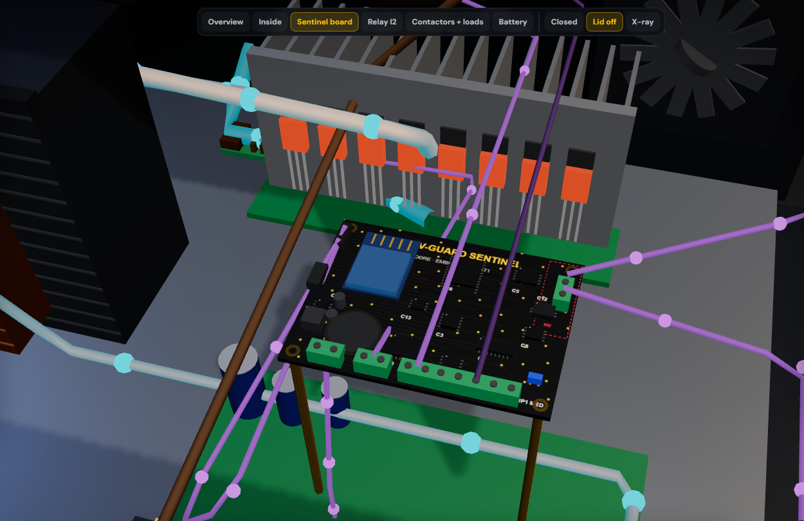
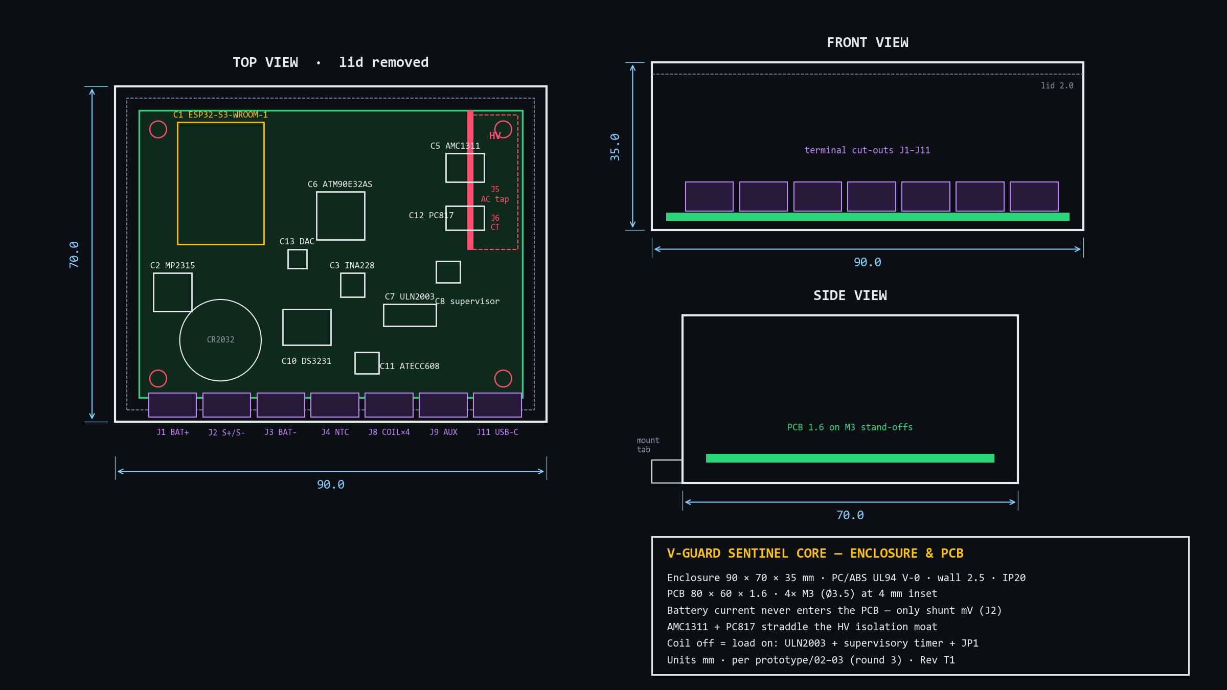
Designed to be built: 90 × 70 × 35 mm, HV zone fenced off.
Mechanical drawing from our round-3 spec, and the same board as a 3D render in the simulation.
Battery current never enters the PCB
only the shunt's millivolts do.
Isolation moat
AMC1311 and PC817 straddle the HV zone.
UL94 V-0 PC/ABS, 4× M3
DIN or screw mount beside the inverter.
V-Guard Sentinel · Big Idea Tech 2026, Track 4 · Team Codey Tingle (TI3271)
10
Notes:
[3:45–4:00] It's designed to be built. Enclosure 90 by 70 by 35, board 80 by 60, flame-retardant plastic. Two things we'd point an engineer to: the battery's 30-plus amps never touch our board — only the shunt's millivolts do — and the mains-side sensing sits behind an isolation moat that the isolated amplifier and optocoupler straddle. On the right, the same board as a 3D render with every chip where the drawing puts it.

Slide 11
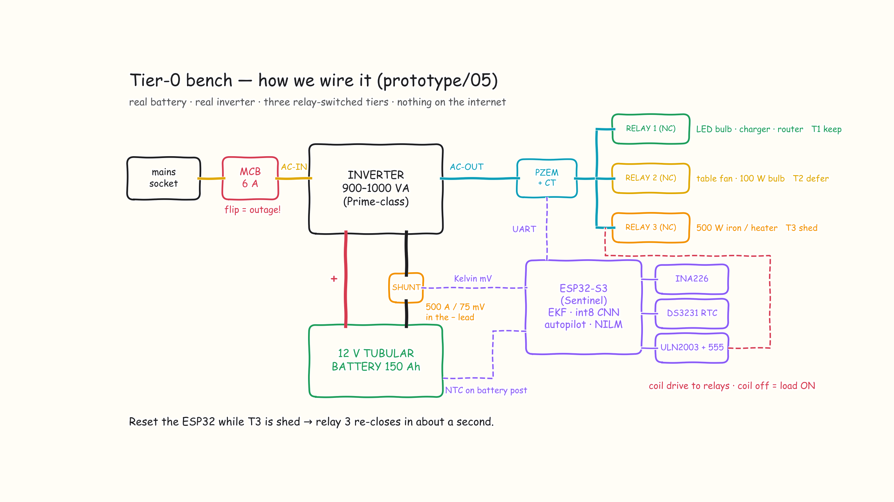
And this is exactly how the bench is wired.
Tier-0 demonstrator from prototype doc 05 — every part available from Indian distributors today.
V-Guard Sentinel · Big Idea Tech 2026, Track 4 · Team Codey Tingle (TI3271)
11
Notes:
[4:00–4:10] And the simplest version — our bench sketch. Mains through a 6-amp MCB into a Prime-class inverter, a 150 Ah tubular battery with the shunt in its negative lead, an ESP32, and three normally-closed relays for the three tiers. Flipping that MCB is our outage. Let's do exactly that, live.

Slide 12

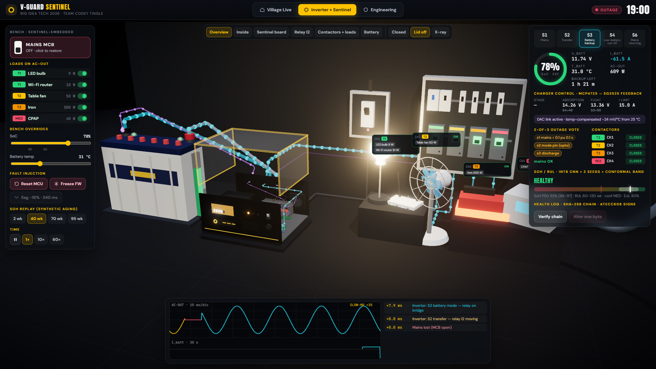
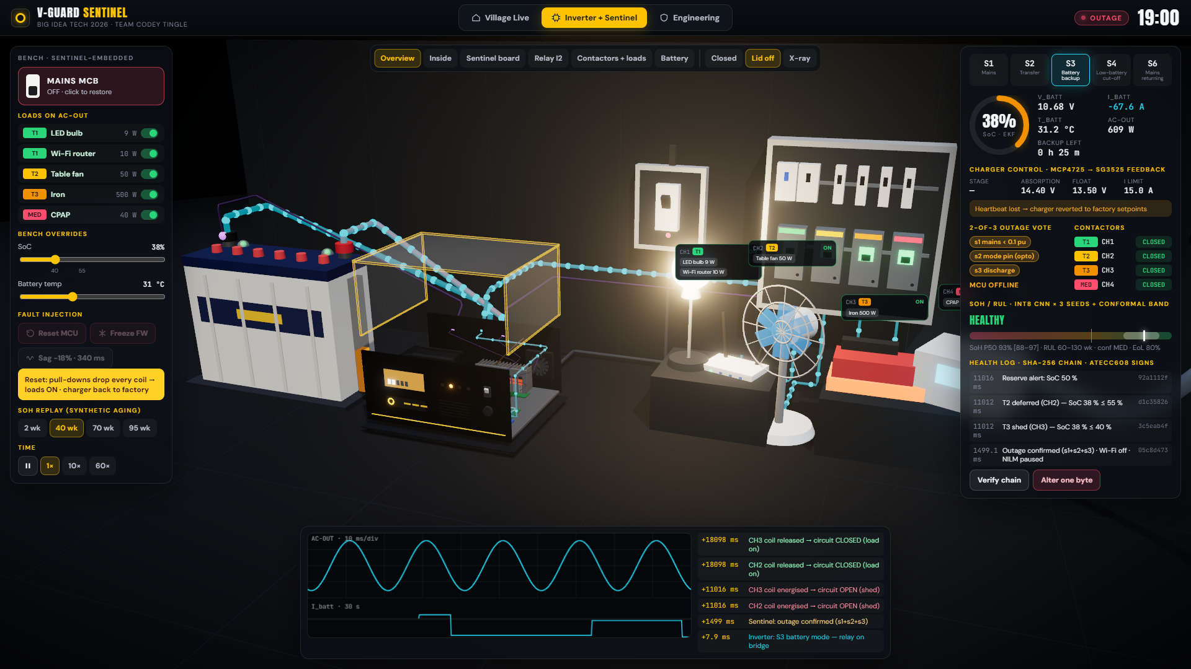
Let's watch it happen — live.
Sentinel Live runs offline in one HTML file. Three moments to watch for:
1 · The village
2 · Flip the MCB
3 · Crash it
Feeder cuts at 7 pm. Watch Home 6 go dark at 10:03 while its twin stays lit.
Relay swings in slow motion: 8 ms gap on the scope, outage confirmed in 1.5 s.
Drop SoC below 40 % → the iron sheds. Reset the chip → every load comes back.
V-Guard Sentinel · Big Idea Tech 2026, Track 4 · Team Codey Tingle (TI3271)
12
Notes:
[4:10–8:10] LIVE DEMO (about 4 minutes). Switch to Sentinel-Live.html, full screen.
1) Village tab: press ⏭ 18:58 at 180×. Feeder drops at 19:00 — flows turn cyan, street lights go out. Click Home 1 → Power corner: point at shunt, NTC, CT, Sentinel, contactors. ⏭ 20:20: T2 deferred (bedroom dark). ⏭ 21:55: at 22:03 Home 6 goes DARK; Home 1 still lit. Press Reset MCU on Home 1: all loads back, re-shed after reboot.
2) Inverter + Sentinel tab: switch the iron on. Click MAINS MCB → slow motion: relay swings, scope shows the 8 ms gap gold→cyan, timeline +0.0 / +8.0 ms, Sentinel confirms at ~1.5 s. Hover the board: C1 ESP32, C6 metering, C13 DAC.
3) Drag SoC to 38 % → CH3 opens, iron goes cold; fan deferred. Reset MCU → everything back, charger reverts to factory. Restore MCB → S6 then bulk charging. Temp slider to 45 °C → setpoints drop, current derates. Verify chain → alter one byte → broken.
Back to slides.

Slide 13
What's proven, what's synthetic, and what still needs hardware.
We'd rather you trust three honest columns than one shiny number.
245
6
3 %
13 / 13
automated tests, all passing
C modules bit-identical to Python
Kalman SoC error vs 7.2 %/week naive
grid dips detected
PROVEN IN CODE
SYNTHETIC ONLY
NEEDS HARDWARE / DATA
▪ int8 model exported + golden self-test in C
▪ autopilot: 50 / 50 C scenarios, zero chatter
▪ signed log: tamper, delete, replay caught
▪ SoH 8.2 pt on simulated tubular batteries
▪ RUL band calibrated (0.99) but wide
▪ NILM / PQ on synthetic streams
▪ ESP32 flash + latency on silicon
▪ real bench: battery, CT, relays
▪ aging campaign → real SoH accuracy
V-Guard Sentinel · Big Idea Tech 2026, Track 4 · Team Codey Tingle (TI3271)
13
Notes:
[8:10–8:40] Credibility is the whole game with R&D judges, so here it is plainly. Proven in code: 245 tests, six C modules that match Python bit for bit, an int8 model that self-tests in C, and a signed log that catches tampering — you just saw it break. Synthetic only: the battery-health accuracy and the appliance numbers, because no real tubular aging data exists yet. Needs hardware: flashing to the ESP32, the physical bench, and the aging campaign. We also cut federated learning from this prototype on purpose — it's designed, not built.

Slide 14
Two SKUs, one board — for 5–14 % of what one battery costs.
Cost stated by the engines each tier enables (design decision D7), against a ₹15 k tubular battery.
Sentinel-Embedded
₹1,650–2,050
Inside new V-Guard inverters. Taps the inverter's own shunt; controls the charger through a DAC with a hardware ceiling. Life-extension claims live here only.
₹850–1,300
₹1,050
₹750
₹450–700
Sentinel-Retrofit
Box beside any inverter. External shunt, NTC, CT and 4 fail-safe contactors. Advisory on charging, protective on loads. ≈ 2.6 mA average draw.
V-Guard Sentinel · Big Idea Tech 2026, Track 4 · Team Codey Tingle (TI3271)
14
Notes:
[8:40–9:05] The product is one board sold two ways. Embedded inside new inverters, it adds 450 to 1,300 rupees. As a retrofit for the millions already installed, 750 rupees for the basic battery-and-autopilot box, up to about 2,000 with the energy coach. Against a 15,000-rupee battery that's 5 to 14 percent — for knowing when to replace it, and keeping the fridge alive when it matters.

Slide 15
Three validation gates — and what we need to pass the first.
1
2
3
GATE 1 · DATASET
GATE 2 · FIELD PILOT
GATE 3 · PRODUCT
6–8 months · Kochi reliability lab
6 months · 100 retrofit homes
Smart Pro family
24–36 tubular batteries at 3 temperatures × 3 depths → real SoH labels and a measured life-extension number
SoC within 3 %, ≥ 75 % RUL-window hit rate, zero unsafe sheds, fridge/AC F1 ≥ 0.8
Embedded SKU into the inverter that already has Wi-Fi, BLE and the Smart 2.0 app
What V-Guard gains
battery replacements at the right time · warranty by evidence · a premium 'intelligent' tier · a fleet-data moat
What we ask for
one opened Prime-series inverter + charger schematic · ESP32 bench parts · batteries and cyclers for Gate 1
V-Guard Sentinel · Big Idea Tech 2026, Track 4 · Team Codey Tingle (TI3271)
15
Notes:
[9:05–9:35] Our roadmap is written as gates, not dates. Gate one: a proper aging campaign in V-Guard's Kochi reliability lab — that's what turns our synthetic accuracy into real accuracy. Gate two: a hundred retrofit homes for six months with hard pass criteria. Gate three: the embedded version inside the Smart Pro family, which already has Wi-Fi and the app. What V-Guard gets: well-timed battery sales, evidence-based warranty, a premium tier, and data no competitor can buy. What we ask for: one opened Prime inverter with its charger schematic, the bench parts, and lab time.

Slide 16
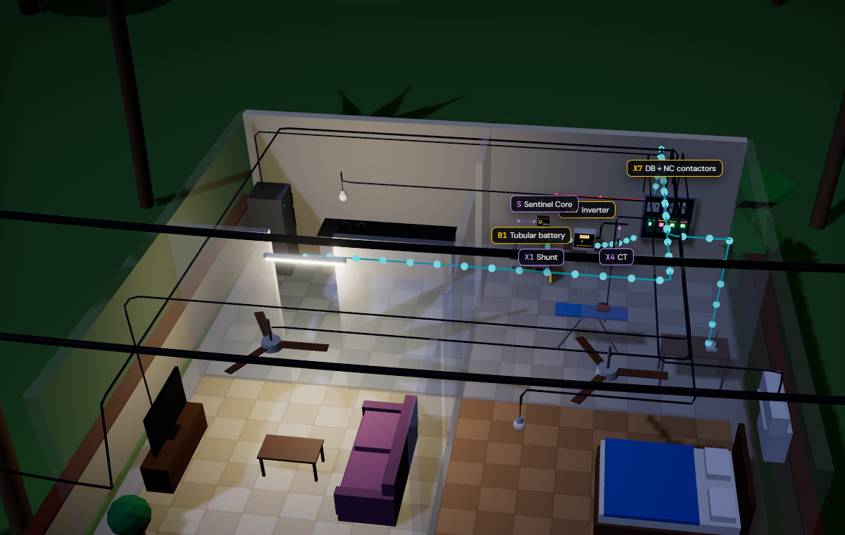
Coil off means loads on.
A window, never a date.
Offline first, fleet second.
Thank you — we'd love your questions.
Team Codey Tingle (TI3271)
Notes:
[9:35–10:00] Three lines to remember. Coil off means loads on — it fails safe. A window, never a date — it's honest about uncertainty. Offline first, fleet second — it works in the village before it ever talks to the cloud. Thank you — we'd love your questions. (Appendix slides follow for Q&A.)

Slide 17
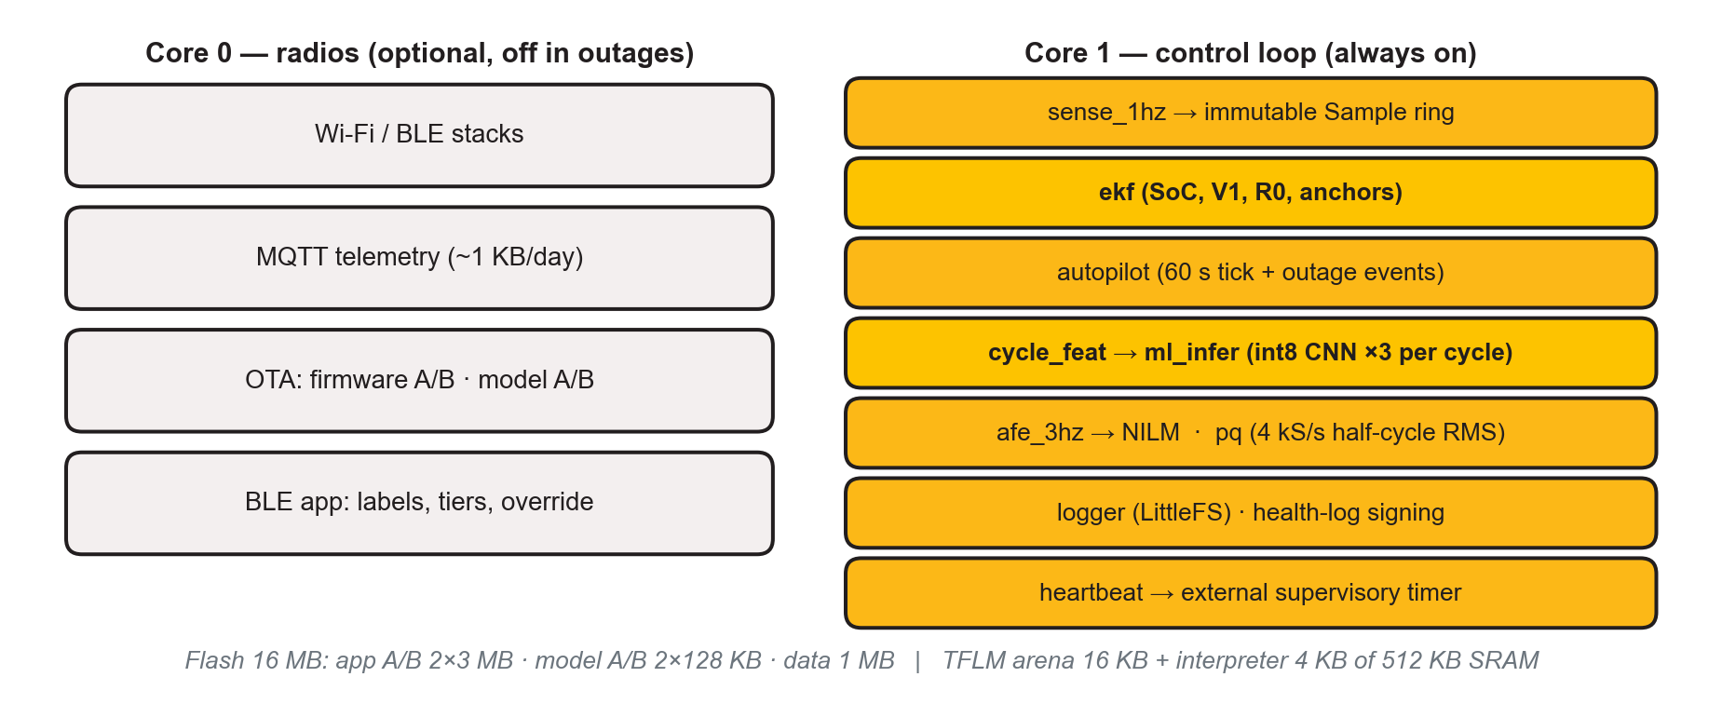
Q&A · Firmware: two cores, no network needed.
APPENDIX · Q&A
Fixed int8 weights in flash · one inference per outage cycle · no training on the device · task watchdog + external supervisory timer.
V-Guard Sentinel · Big Idea Tech 2026, Track 4 · Team Codey Tingle (TI3271)
17
Notes:
If asked about firmware / RTOS / memory: ESP-IDF, FreeRTOS, Core 1 runs sensing, EKF, autopilot, ML, NILM, PQ, logger; Core 0 radios only. Heartbeat task feeds the external supervisory timer only when every critical task checked in.

Slide 18
Q&A · Every part on the board, and the job it does.
APPENDIX · Q&A
C1
ESP32-S3-WROOM-1 N16R8 the brain: EKF, int8 CNN, NILM, PQ, autopilot
C8
Supervisory timer no heartbeat for 2 s → all coils off
C2
MP2315 buck power from the 12 V battery (≈ 2.6 mA avg)
C9
JP1 medical jumper one channel can never be shed
C3
INA228 shunt mV + battery V; hardware coulomb counter
C10
DS3231 + CR2032 time of day through outages
C4
NTC input battery temperature
C11
ATECC608 private key signs the health log
C5
AMC1311 isolated fast AC tap: outage, sag, swell
C12
PC817 inverter mode line → outage vote s2
C6
ATM90E32AS P, Q, PF at 3 Hz for the energy coach
C13
MCP4725 (Embedded) charge-setpoint offset into SG3525 feedback
C7
ULN2003 4 × 12 V coil drivers; coil off on reset
C14
USB-C · LEDs · TVS service and protection
V-Guard Sentinel · Big Idea Tech 2026, Track 4 · Team Codey Tingle (TI3271)
18
Notes:
Parts traceability from prototype doc 03. INA228 breakouts aren't sold in India, so the Tier-0 bench uses INA226 + PZEM-004T; Tier 1 places ATM90E32AS on our own PCB.

Slide 19
Q&A · Corrections to our own report.
APPENDIX · Q&A
From the design register — the positions we defend.
D1
A battery shunt can't see appliances
→ added a metering front-end + CT on AC-OUT
D2
Retrofit can't command the charger
→ split into Embedded (controls) and Retrofit (advises)
D3
Float voltage isn't open-circuit voltage
→ anchor SoC on charge taper; OCV only after true rest
D8
'Fail-safe' needed a mechanism
→ NC contactors, pull-downs, supervisory timer, medical jumper
D12
Uncertainty method unspecified
→ quantile heads + 3 seeds + conformal band → a window
D15
Federated learning in the prototype
→ cut on purpose: designed, not built
D16
'Neural accelerator', 'microamp draw'
→ ESP-NN vector extensions; ≈ 2.6 mA average
V-Guard Sentinel · Big Idea Tech 2026, Track 4 · Team Codey Tingle (TI3271)
19
Notes:
If asked 'what changed since round 2?': these are the design decisions D1–D17 in design/12. Leading with our own corrections builds trust.

Slide 20
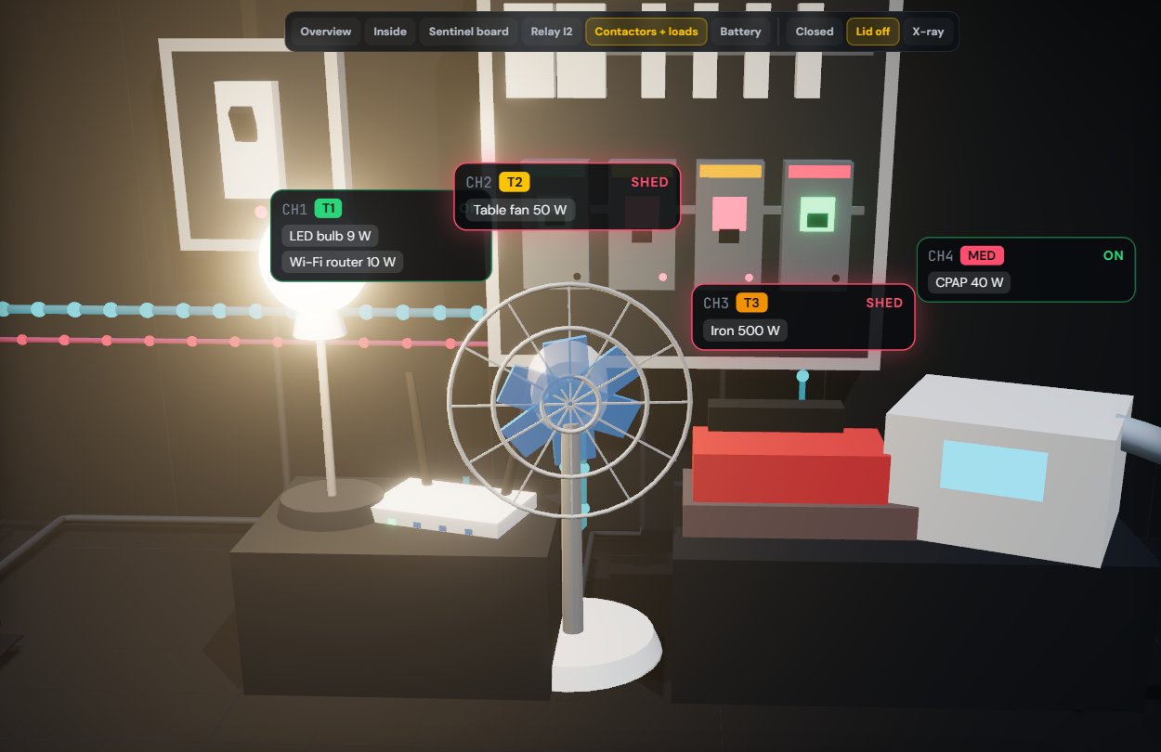
Q&A · Safety and standards we design to.
APPENDIX · Q&A
Isolation
reinforced AMC1311 barrier; HV zone behind a moat; TVS on every line
Fail-safe
NC contactors — any fault, reset or brown-out brings loads back
Standards
IS 13252 / IEC 62368-1 (BIS gate) · IEC 62040 UPS · IEC 61000 EMC · IEEE 1159 / IEC 61000-4-30 Class-S-like PQ · UL94 V-0 enclosure
Charging
−24 mV/°C compensation, derate above 45 °C, stop at 58 °C, 2 s heartbeat revert to factory
V-Guard Sentinel · Big Idea Tech 2026, Track 4 · Team Codey Tingle (TI3271)
20
Notes:
If asked about safety certification: we target IS 13252 / IEC 62368-1 as the BIS gate; PQ is 'Class-S-like', never claimed Class A.

